Slide 1
1. I'd Ih"ERS IT’\’
Project Presentation of Back End Engineering Project (BEE) (22CS026)
On
Examination Portal
Submitted By: Prabhdeep Singh 2210992050 Nimish Sharma - 2210991986
Supervised By
Rahul Shdrma
Department of ComputerScience and Engineering, Chitkara University, Punjab

Slide 2


Project Statement:
In the modern education system, digital assessment platforms play a crucial role in streamlining the examination process. This project, Online Examination Platform, is designed to provide a structured and efficient way to manage online tests, ensuring seamless coordination between administrators, examiners, and smdents. Built using the MERN (MongoDB, Express.js, React.js, Node.js) stack, this platform enables admin users to create courses and assign them to examiners. Examiners can then create and manage tests, performing CRUD (Create, Read, Update, Delete) operations on questions.
Students can take assigned tests, and view their results upon completion. The system ensures a smooth examination process by incorporating secure authentication, automated result calculation, and real-time test management.
With an intuitive user interface and a strucmred workflow, this platform
enhances the efficiency of online assessments while maintaining transparency
and accuracy.

Slide 3




Functionalities:
Admin Dashboard allows admins to manage courses, assign examiners, and oversee platform operations. Admins can create, update, and delete courses while monitoring overall system activity.
Examiner Dashboard enables examiners to create and manage tests for assigned courses. They can add, edit, and delete questions, set test schedules, and automate grading for objective questions. Examiners also have the ability to manually evaluate subjective responses and view student performance reports.
Student Dashboard provides students with access to assigned tests, allowing them to attempt exams within the scheduled timeframe. Students can view their results, track their exam history, and receive notifications for upcoming tests. In future updates, they will also have access to certificates for completed exams.
Role-based access control maintaining security and data privacy through JWT authentication. Future enhancements include cheating prevention mechanisms, graphical analytics for performance tracking, manual checking of subjective questions, real-time notifications, and automated certificate generation for successful test completion.
Registration and Authentication Sign-up/Login: Users can create accounts or log in
using credentials or third-party services (e.g., Google, Facebook).User Profiles: Users can manage personal information, view travel history, and saved trips.

Slide 4
Check Points:
1. Does the project statement result in a product? If yes, what type of product?
Yes, the product is an examination portal.
1. If it is a product, can a prototype be made, if not, what is it, that we can produce that our teachers can evaluate?
Yes, a functional prototype of the website can be made for evaluation.
1. Does the project statement use multiple concepts to achieve the outcome? (yes/no)
yes
1. Does it have enough for our team members to do a sufficient amount of work? (yes / no)
yes

Slide 5
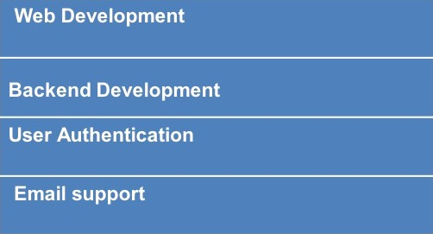
•TechnicaI Nodes
Subject / Area / Topic Technical Nodes
HTML, CSS, JavaScript, React.js, Bootstrap
Node.js, Express.js, MongoDB
JWT, Bcryptjs
Node mailer

Slide 6
Prerequisites (in terms of knowledge, concepts and material) for doing the Project:
Basic knowledge of web development (HTML, CSS, JavaScript) Familiarity with React.js for front-end development
Understanding of backend development with Node.js and Express.js Knowledge of databases (MongoDB)
Experience with user authentication methods
Email integration for password reset is implemented using Nodemailer

Slide 7
Material that ma be re uired to make the and where it mi ht be available
iect
Laptops/computers with internet access
Software tools: VSCode, Node.js, MongoDB (available online for free)

Slide 8
Resources available to us:
Internet access
Online tutorials and documentation
Guidance from professors and mentors

Slide 9


£HITŒBä
UNIVERSITY

Slide 10







Admin Dashboard
Available Courses
Add New Course

Slide 11

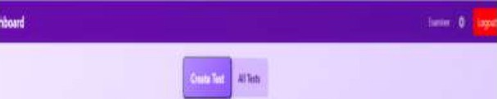






UNIVERSITY
TRt Ï

Slide 12
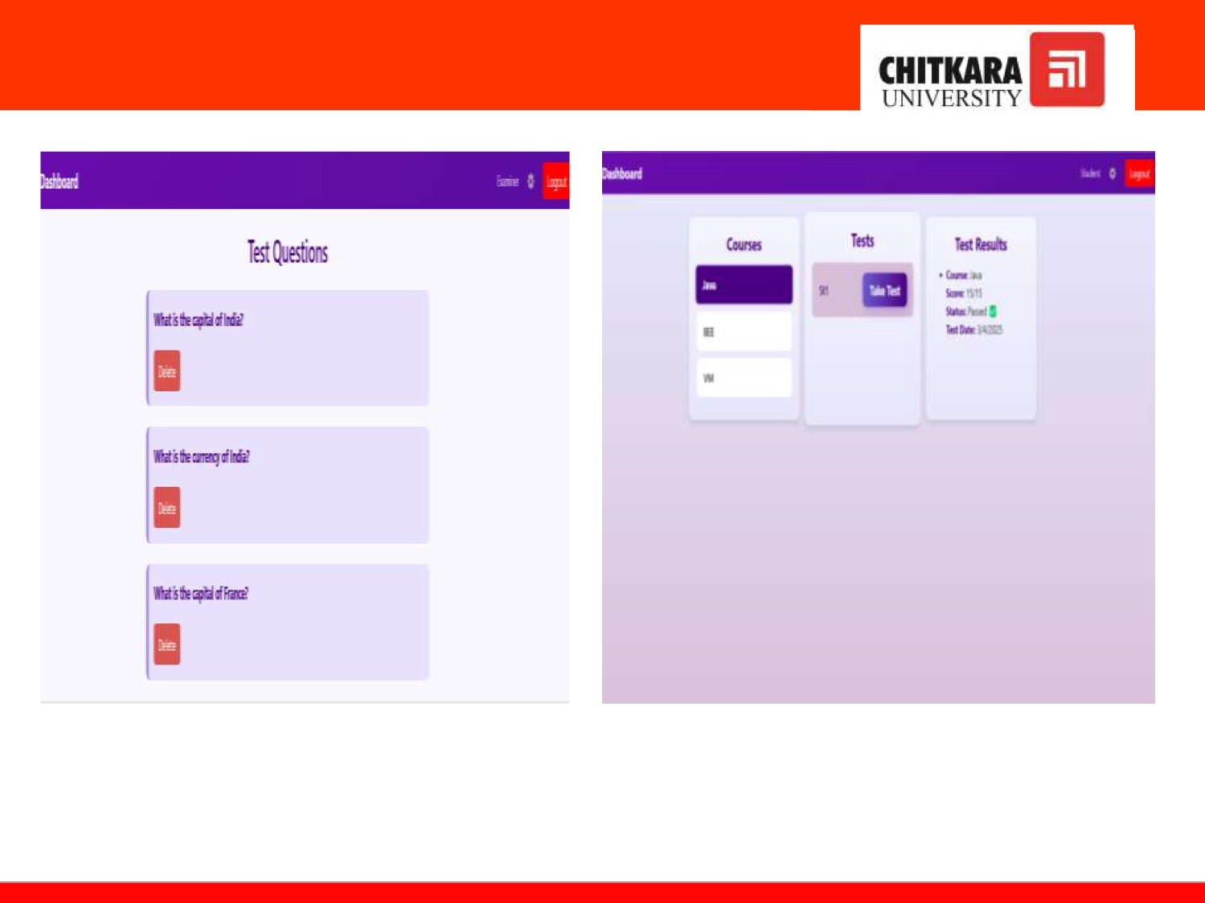

Slide 13
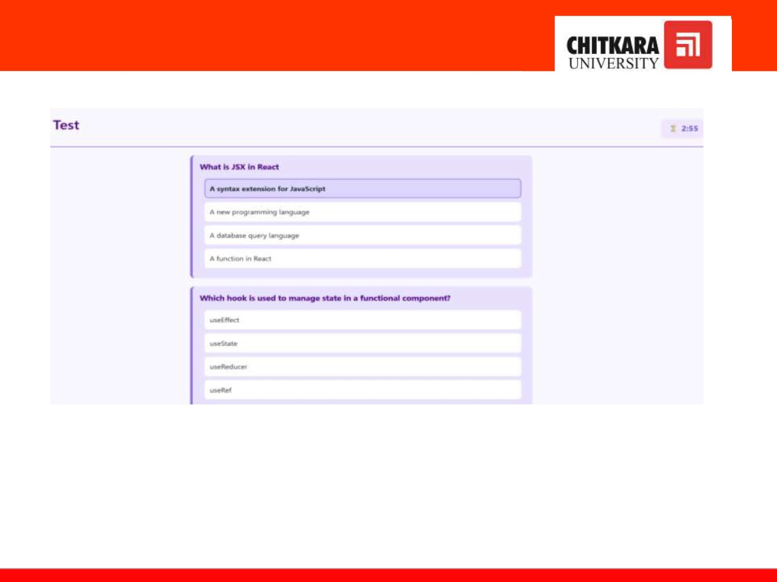

Slide 14

Future Sco e:
Cheating Prevention — Implementing AI-powered proctoring, screen monitoring, and plagiarism detection to ensure fair examination practices.
Charts for Results — Enhancing the platform with graphical analytics, including bar charts and pie charts, to help sNdents and examiners visualize performance trends over time.
Manual Checking of Questions — Introducing an option for examiners to manually evaluate subjective answers, ensuring fair grading for descriptive responses.
Notification for Tests — Implementing email and in-app notifications to remind students about upcoming tests, deadlines, and important updates.
Certificate Generation — Enabling automated certificate generation for sNdents who successfully pass a test, with downloadable PDFs.
Exam History Tracking — Allowing sNdents to view their past test attempts, scores, and progress over time, aiding in self-assessment and improvement.

Slide 15
cxirxæa
UNIVERSITY
SDLC

Slide 16

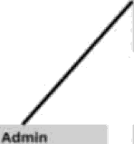

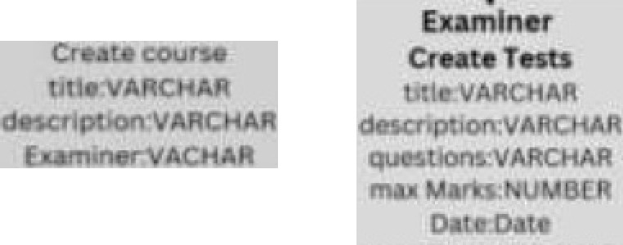



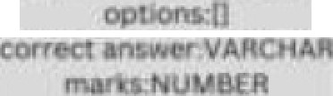
£HITŒBA
LKI\^{F}ERSITY
ernałl VARCHAg pawwPfd úAŃCHĂfi ” i İŸVAÁCH1R
scera!NtjMBER
îøsțłd:Object Ó

Slide 17
Thank You
17

